Slide 1

CYT130 – Final Project
Instructor: Prof. Ferozuddin Hyder
Presented by: Khang Le & Eric Brennan
Date: December 2025
DVWA SQL Injection & vsftpd 2.3.4 Backdoor Exploitation
Notes:
Hello, My name is Eric Rennan and this presentation covers two critical vulnerabilities identified during our penetration testing project: SQL Injection in DVWA and the vsftpd 2.3.4 backdoor. We will explain how each vulnerability works, how it was exploited, and how it can be mitigated. I will present the first exploitation and follow by Khang Le.

Slide 2

What is SQL Injection?
SQL Injecion
Web application vulnerability
Occurs when user input is not sanitized
Allows attackers to modify SQL queries
Can expose or manipulate database data
Notes:
SQL Injection is a vulnerability that occurs when a web application directly includes user input in SQL queries without proper validation. This allows attackers to inject malicious SQL code into the database.

Slide 3

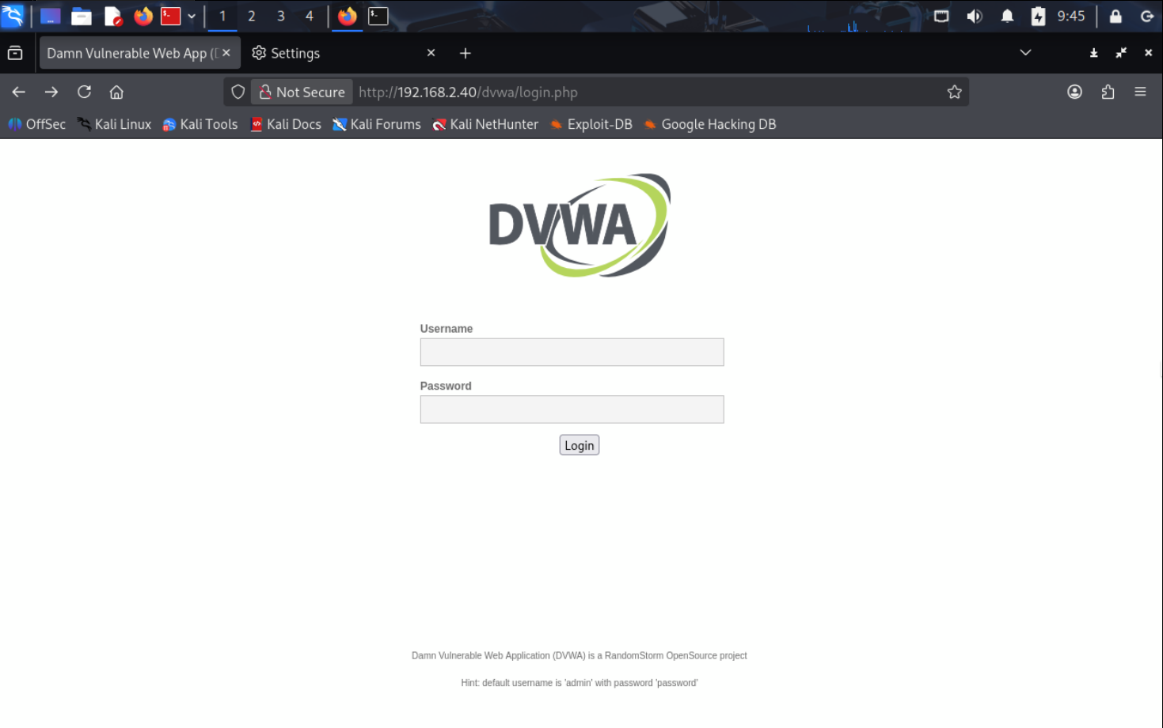
DVWA Target Overview
Damn Vulnerable Web Application (DVWA)
SQL Injection module
Vulnerable parameter: id
HTTP GET request
URL example:
/dvwa/vulnerabilities/sqli/?id=
Notes:
The target is the SQL Injection module within DVWA. The vulnerable parameter is the id field, which is passed through a GET request and directly processed by the backend database.

Slide 4

How the Vulnerability Was Found
Manual input testing
Entered ‘ into the id field
Application returned SQL error
Confirms improper input handling
Notes:
We identified the vulnerability by manually entering a single quotation mark into the input field. The application returned an SQL error, confirming that user input was not being properly sanitized.

Slide 5
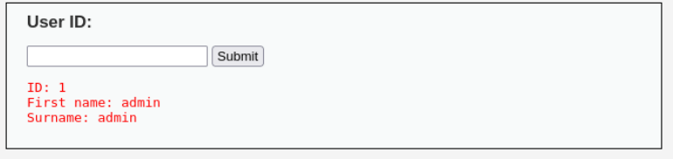
SQL Injection Exploitation
Pauload used:
1' UNION SELECT user(), database() #
Result:
Database user: root@localhost
Database name: dvwa
Notes:
Using a UNION-based SQL injection payload, we were able to extract sensitive database information. This confirms that arbitrary SQL commands can be executed through the vulnerable parameter.

Slide 6
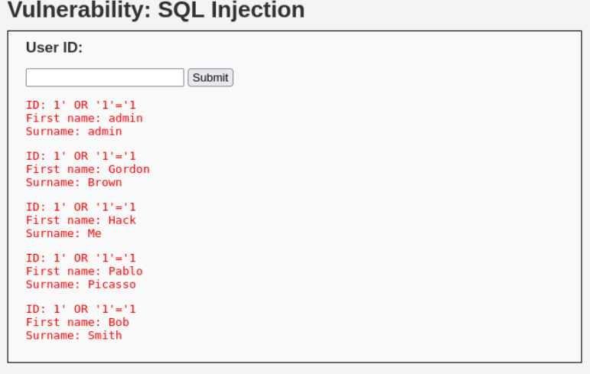
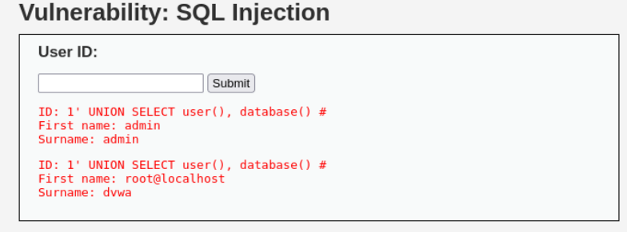
Affected areas
1

Slide 7
SQL Injection Impact & Risk
Impact:
Extract sensitive data
Modify or delete database records
Bypass authentication
Risk Rating:
High impact, easy exploitation
Notes:
The impact of SQL Injection includes data theft, data modification, and authentication bypass. Because exploitation is simple and the impact is severe, this vulnerability is rated as high risk.

Slide 8

SQL Injection Mitigation
Recommendations:
Use prepared statements
Validate and sanitize user input
Apply least-privilege database access
Disable detailed SQL error messages
Notes:
To mitigate SQL Injection, developers should use prepared statements, validate all user input, restrict database privileges, and avoid exposing detailed error messages.

Slide 9

What is vsftpd 2.3.4 Backdoor?
Malicious backdoored FTP service
Allows unauthenticated access
Spawns hidden root shell
Leads to full system compromise
Notes:
The vsftpd 2.3.4 vulnerability is not a misconfiguration but a malicious backdoor built into the service, allowing attackers to gain root access without authentication.

Slide 10
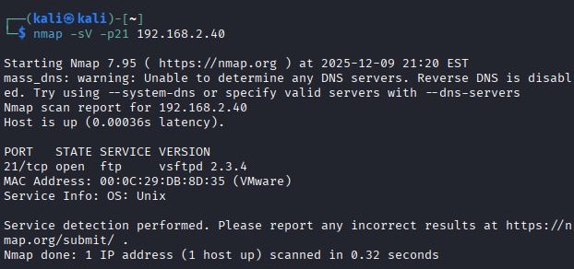
Service Discovery
Service Identificationn:
map -sV -p21 <target IP>
Result:
FTP service detectedVersion: vsftpd 2.3.4
Notes:
During enumeration, we used Nmap to identify running services. The scan revealed the presence of vsftpd version 2.3.4, which is a known backdoored FTP service.

Slide 11
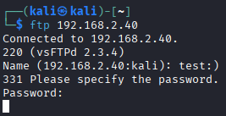
Triggering the Backdoor
Backdoor Activation:
FTP login attempt
Username contains :)
Password irrelevant
Notes:
The backdoor is triggered by submitting a username containing a smiley face. Although the login fails, it silently activates a hidden root shell.

Slide 12
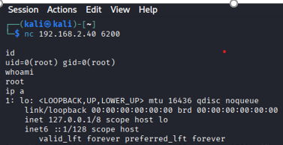
Gaining Root Access
Connecting to Backdoor Shell
nc <target IP> 6200
Verification
Id
uid=0(root)
Notes:
After triggering the backdoor, we connected to port 6200 using Netcat. Running the id command confirmed that we gained root access.

Slide 13

vsftpd Impact & Risk
Impact:
Full system compromise
Root-level access
No credentials required
No logging or alerts
Risk Rating:
Critical
Notes:
This vulnerability allows complete system takeover with no authentication. Because of its severity and ease of exploitation, it is classified as critical.

Slide 14
vsftpd Mitigation
Recommendations:
Remove vsftpd 2.3.4 immediately
Disable FTP service
Use SFTP or FTPS
Restrict port 21 access
Conduct service audits
Notes:
To mitigate this issue, the vulnerable FTP service must be removed or replaced with secure alternatives, and access to FTP ports should be restricted.

Slide 15

Conclusion
Key Takeaways:
SQL Injection compromises application data
vsftpd backdoor compromises the entire system
Legacy services pose severe risks
Patch management is essential
Notes:
In conclusion, SQL Injection affects application-level security, while the vsftpd backdoor results in total system compromise. These findings emphasize the importance of secure coding and proper patch management.

Slide 16
References
Nmap Project. (n.d.). Nmap Network Scanning Documentation. Retrieved from
https://nmap.org/book/man.html
• Rapid7. (n.d.). Metasploit Framework User Guide. Retrieved from
https://docs.rapid7.com/metasploit/
• MITRE. (n.d.). CVE List. Retrieved from https://cve.mitre.org
• OWASP Foundation. (2015). OWASP Testing Guide v4. Retrieved from
https://owasp.org/www-project-web-security-testing-guide/
• Seneca College. (2024). CYT130 Lecture Notes: Labs 8–11. School of Information
Technology Administration and Security.

Slide 17
THANKS
Thank you, Prof. Hyder — you’ve been my favorite instructor this semester.

